Slide 1



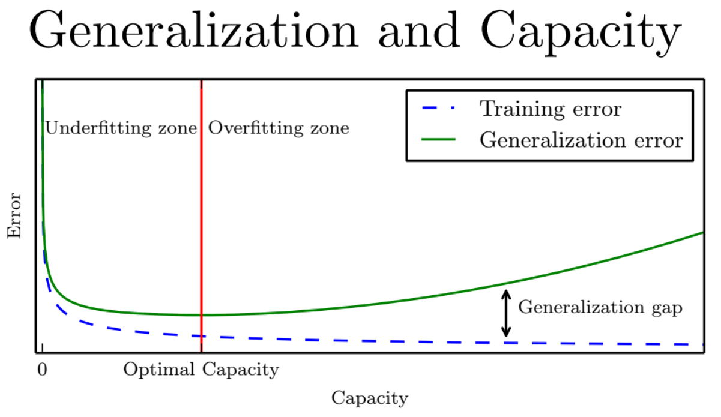
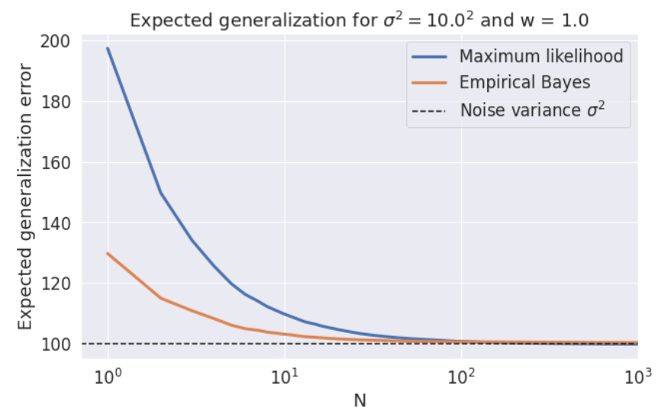
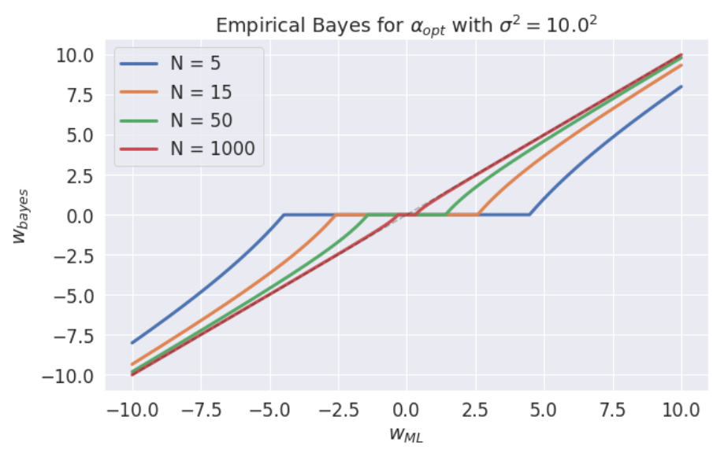
Generalization
Hyper parameters – Empirical Bayes unless n<<
Generalization Error from CV with appropriate loss function

Slide 2



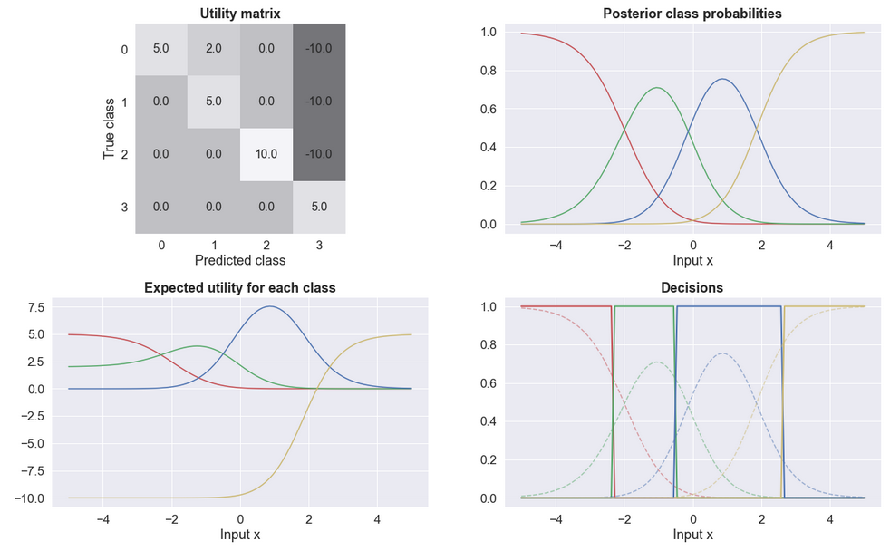
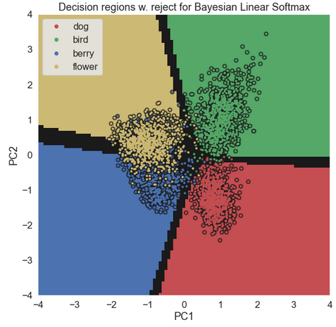
Decision Theory
3 – Healthy
2,1,0 – Ill
2 – Standard treatment (Default)
1 – Should be default if 1 or 0
0 – Experimental

Slide 3
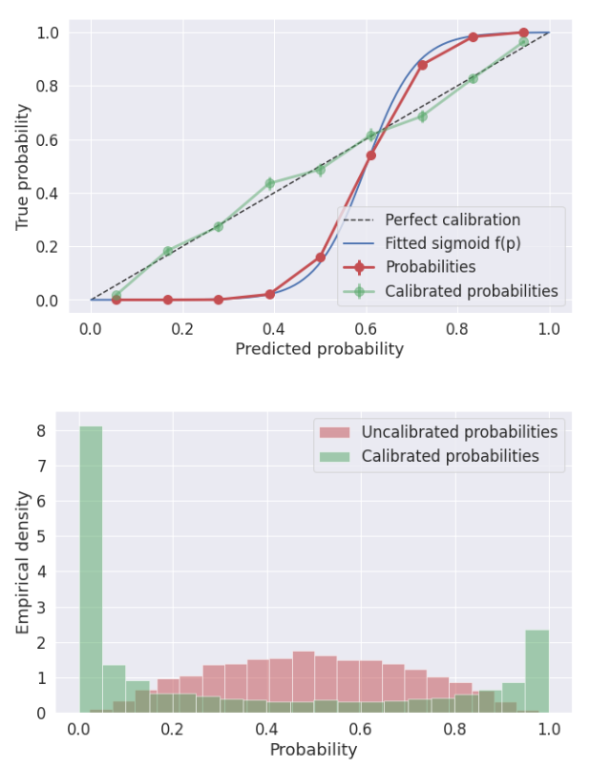

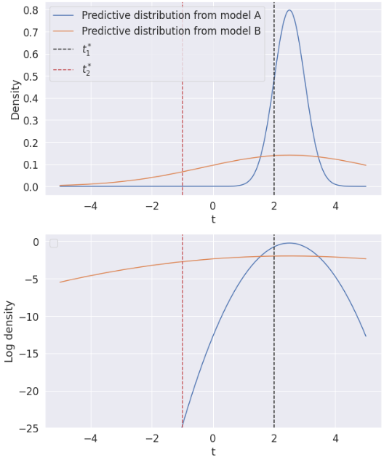

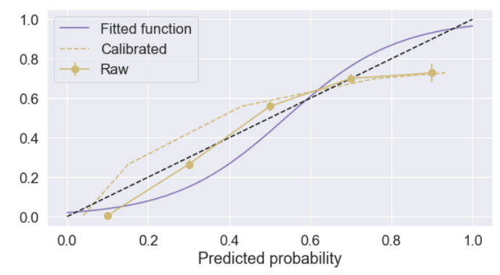
Calibration and LLPD
log pointwise predictive density
Platt scaling:

